Slide 1
POSHAN ABHIYAAN

Slide 2
ABSTRACT
Promoting holistic nutrition among women and children with the help of IT for Poshan Abhiyaan.
Design a system to provide information on nutrition and trigger notifications for women/child about the upcoming vaccine dosage.

Slide 3
INTRODUCTION
Our Web Application facilitates young parents in tracking the immunization of their children.
The application takes away pressure of having to remember life critical information amidst juggling work and home for the parents.
The objective of this Portal, is to provide healthcare related information to the citizens of India and to serve as a single point of access for consolidated health information. Women and children have always been a focal audience in its vision.

Slide 4
Software Requirements
• Spring Framework
• MySQL
• Apache Tomcat Server
• InternetBrowser

Slide 5
LITERATURE SURVEY
Spring framework
Spring boot application
MySQL
Tomcat server
ChatterBot

Slide 6


Slide 7

HOME PAGE

Slide 8
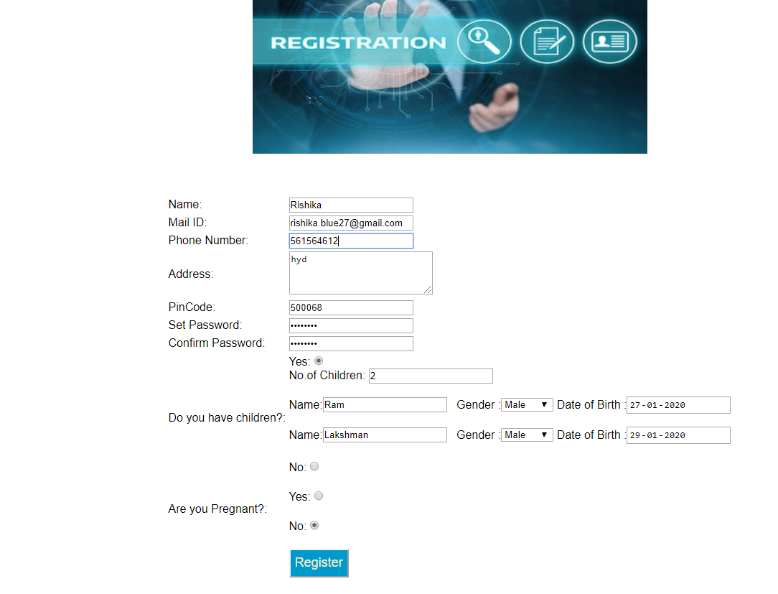
REGISTRATION PAGE

Slide 9

EMAIL VALIDATION:

Slide 10

LOGIN SCREEN

Slide 11
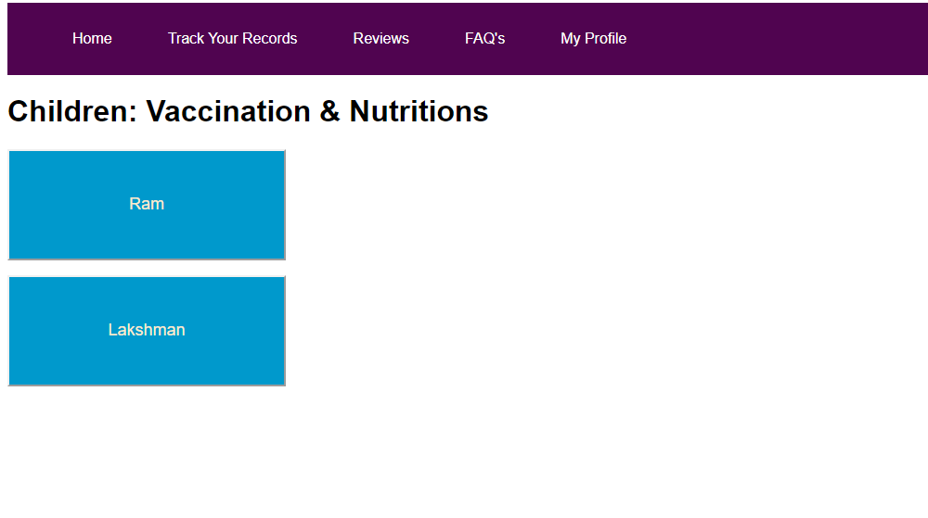
USER HOME_PAGE

Slide 12
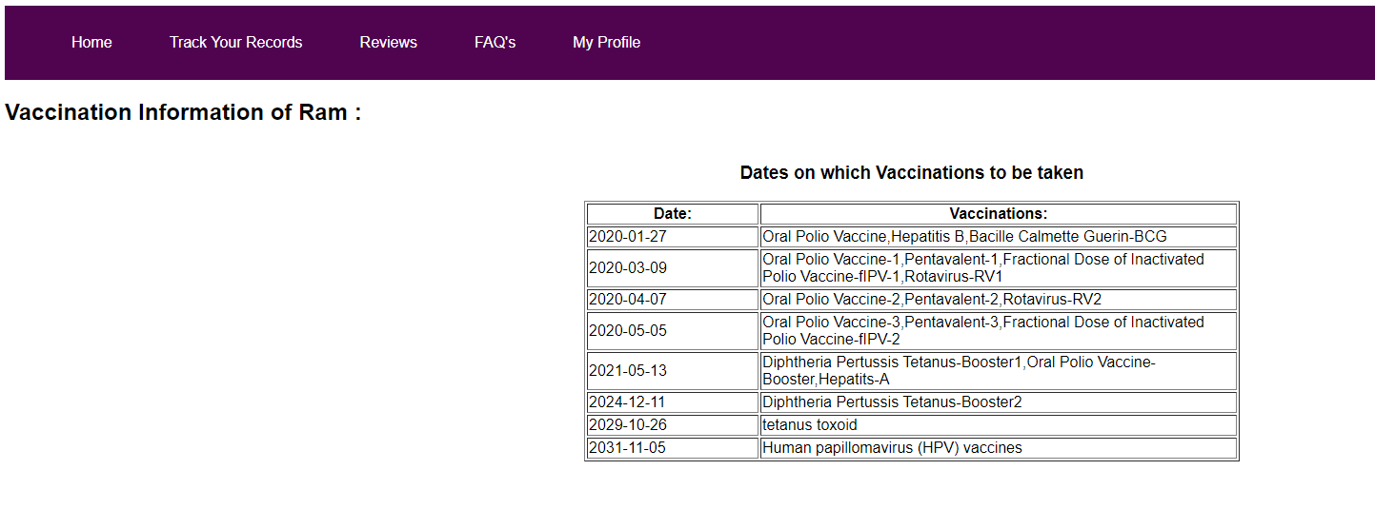
Vaccination dates info child:

